Slide 1


Data Communication
By Dr Sanjeev

Slide 2
Introduction

Slide 3
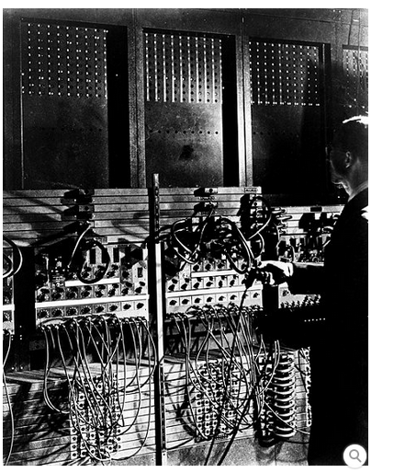
Journey of Computers
Computation Becomes Electronic
World War II acted as midwife to the birth of the modern electronic computer.
Unprecedented military demands for calculations—and hefty wartime budgets—spurred innovation.

Slide 4
Journey of Computers
Computation Becomes Electronic
Early electronic computers were one-of-a-kind machines built for specific tasks.
But setting them up was cumbersome and time-consuming.
The revolutionary innovation of storing programs in memory replaced the switches and wiring with readily changed software.

Slide 5
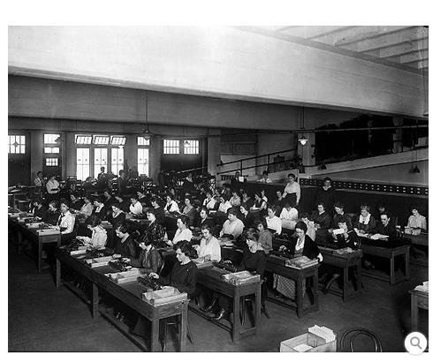
Journey of Computers
Large-scale tabulating operation
This scene captures a typical hierarchy of calculation workers: seated low-skilled punch operators in the majority, their immediate supervisors standing behind them, a few sorting-machine operators nearer the windows, and their supervisors behind them.

Slide 6
Journey of Computers
a few sorting-machine operators
supervisors standing behind them,
low-skilled punch operators

Slide 7
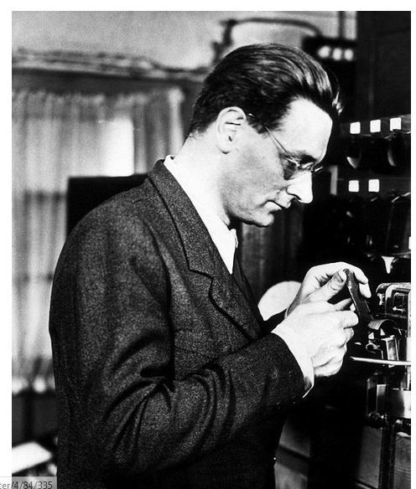
Journey of Computers
Konrad Zuse (1910-1995)
Zuse was a brilliant engineer who worked independently to build programmable computers, but his early machines were destroyed in World War II.
After the war, his company Zuse KG became a successful computer manufacturer

Slide 8
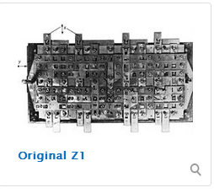
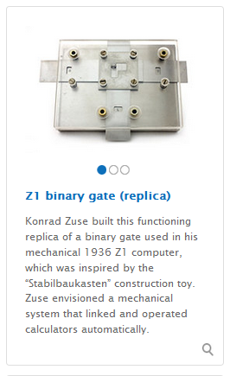
Journey of Computers
Konrad Zuse was bored. A civil engineering student in Berlin, he hated his job’s tedious calculations. So, as an engineer in 1936, he began assembling metal plates, pins and discarded movie film.

Slide 9
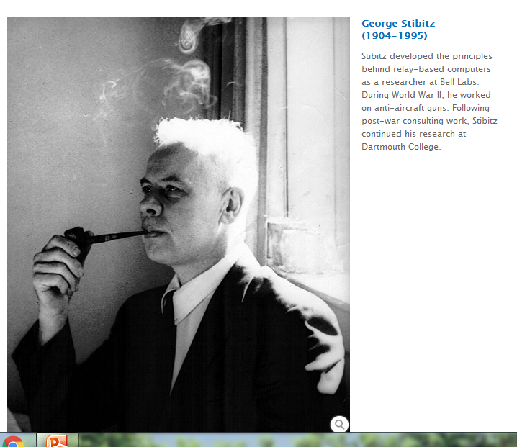
Journey of Computers

Slide 10
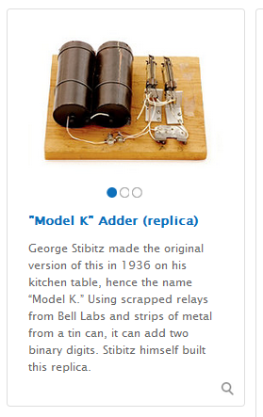
Journey of Computers

Slide 11
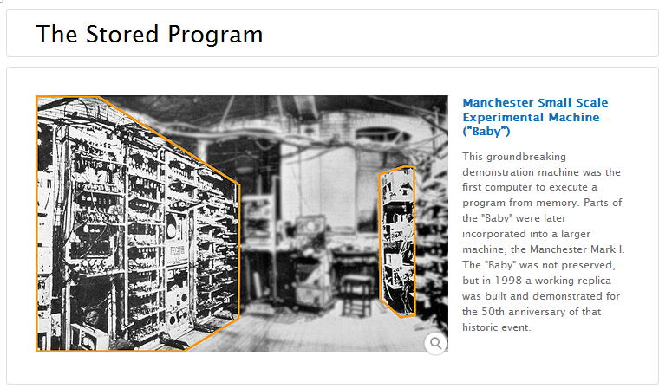
Journey of Computers

Slide 12
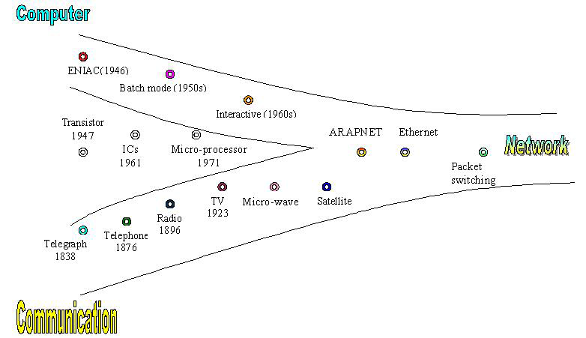
Evolution of computer N/W

Slide 13
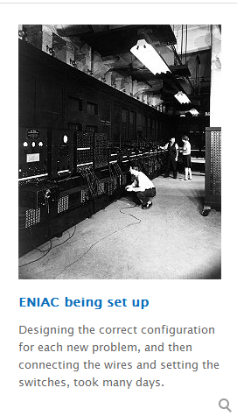
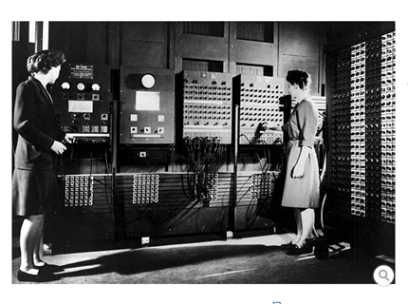
ENIAC Electronic Numeric Integrator and Computer

Slide 14
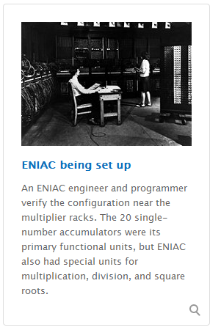
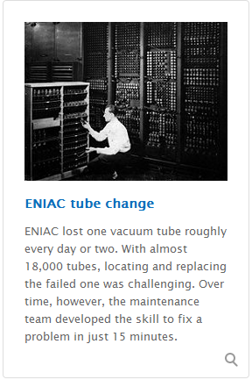
ENIAC Electronic Numeric Integrator and Computer

Slide 15
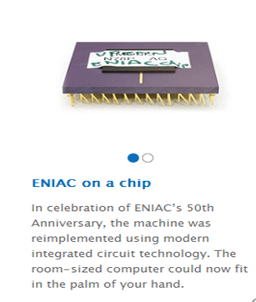
ENIAC Electronic Numeric Integrator and Computer

Slide 16
Concept of Data Communication
Human beings are the only creatures on the earth who are able to communicate with each other through the medium of language.
But humans take this gift to another extent. Distance, time, and physical existence of the person don’t matter in communication these days because they build a communication system through which they can communicate or share data like images, videos, text, files, etc with their loved ones anytime anywhere.
Communication is defined as a process in which more than one computer transfers information, instructions to each other and for sharing resources.

Slide 17
The term “Data Communication” comprises two words: Data and Communicate
Thus, data communication refers to the exchange of data between two or more networked or connected devices. These devices must be capable of sending and receiving data over a communication medium.
Examples of such devices include personal computers, mobile phones, laptops, etc.

Slide 18
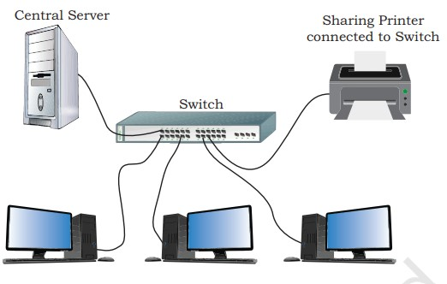
Network of computing Device

Slide 19
COMPONENTS OF DATA COMMUNICATION
Whenever we talk about communication between two computing devices using a network, five most important aspects come to our mind.
These are sender, receiver, communication medium, the message to be communicated, and certain rules called protocols to be followed during communication.
The communication media is also called transmission media. Figure shows the role of these five components in data communication.

Slide 20
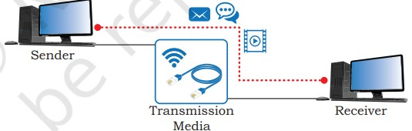
Components

Slide 21
A communication system is made up of the following components:
Message:
A message is a piece of information that is to be transmitted from one person to another. It could be a text file, an audio file, a video file, etc.
Sender:
A sender is a computer or any such device which is capable of sending data over a network. It can be a computer, mobile phone, smartwatch, walkie talkie, video recording device, etc.
Receiver:
A receiver is a computer or any such device which is capable of receiving data from the network. It can be any computer, printer, laptop, mobile phone, television, etc. In computer communication, the sender and receiver are known as nodes in a network.

Slide 22
Communication media: It is the path through which the message travels between source and destination. It is also called medium or link which is either wired or wireless. For example, a television cable, telephone cable, ethernet cable, satellite link, microwaves, etc.
Protocols: It is a set of rules that need to be followed by the communicating parties in order to have successful and reliable data communication. You have already come across protocols such as Ethernet and HTTP.

Slide 23
Protocols:
Set of rules (Protocol): When someone sends the data (The sender), it should be understandable to the receiver also otherwise it is meaningless. For example, A sends a message to B.
If Sanjeev writes in Hindi and Sonia cannot understand Hindi, it is a meaningless conversation.
Therefore, there are some set of rules (protocols) that is followed by every computer connected to the internet and they are:
Internet Protocol (IP)
Transmission Control Protocol (TCP)

Slide 24
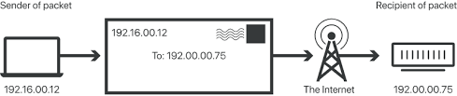
Internet Protocol:
Do You ever wonder how does computer determine which packet belongs to which device.
What happens if the message you sent to your friend is received by your father? Scary Right.
Well! IP is responsible for handling the address of the destination computer so that each packet is sent to its proper destination.

Slide 25
Transmission Control Protocol
It is a set of standardized rules that uses a client-server model of communication in which a user or machine (a client) requests a service by a server in the network
TCP ensures that the message or data is broken into smaller chunks, called IP packets.
Each of these packets are routed (transmitted) through the Internet, along a path from one router to the next, until it reaches the specified destination.
TCP guarantees the delivery of packets on the designated IP address. It is also responsible for ordering the packets so that they are delivered in sequence.

Slide 26
Protocols also define:
how computers identify one another on a network.
01
• the form to which the data should be converted for transit.
02
• how to decide whether the data received is for that node or to be forwarded to another node.
03
• ensuring that all the data have reached the destination without any loss.
04
• how to rearrange the packets and process them at the destination.
05

Slide 27
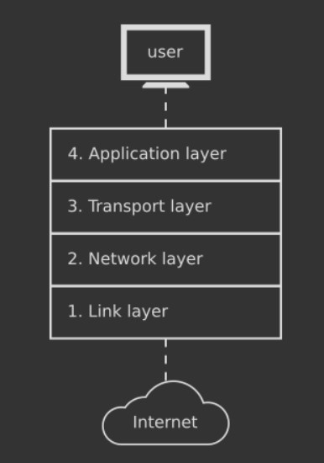
Working: IP/TCP

Slide 28
Types of Data Communication
Data Communication
Simplex Communication
Half-duplex Communication
Full Duplex Communication

Slide 29
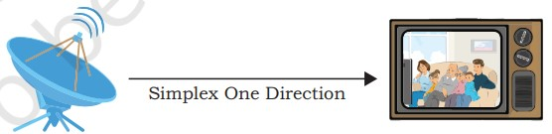
Simplex Communication:
It is a one way or unidirectional communication between two devices in which one device is sender and other one is receiver.
Devices use the entire capacity of the link to transmit the data.
It is like a one way street where vehicles can move in only one direction.
For example, data entered through a keyboard or audio sent to a speaker are one way communications.

Slide 30
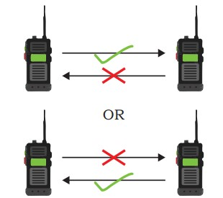
Half Duplex Communication
It is two-way or bidirectional communication between two devices in which both the devices can send and receive data or control signals in both directions, but not at the same time
While one device is sending data, the other one will receive and vice-versa. It is like sharing a one-way narrow bridge among vehicles moving in both directions.
Vehicles cannot pass the bridge simultaneously.
Basically, it is a simplex channel where the direction of transmission can be switched.
Application of such type of communication can be found in walkie-talkie where one can press the push-to-talk button and talk

Slide 31
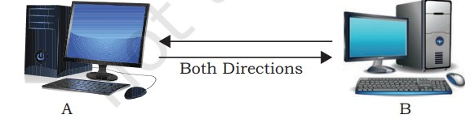
Full Duplex Communication
It is two way or bidirectional communication in which both devices can send and receive data simultaneously.
It is like a two way road where vehicles can go in both directions at the same time.
This type of communication channel is employed to allow simultaneous communication, for example, in our mobile phones and landline telephones
The capacity of the transmission link is shared between the signals going in both directions.
This can be done either by using two physically separate simplex lines — one for sending and other for receiving, or the capacity of the single channel is shared between the signals travelling in different directions.

Slide 32
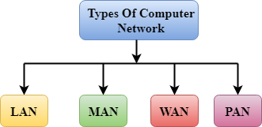
NETWORK TYPES

Slide 33
Based on Scale
They are divided into:
Local Area (LAN)
Metropolitan Area Network (MAN)
Wide Area Networks (WAN).
The other types can be
Personal Area N/W PAN
Body Area N/W BAN
Home Area N/W HAN
Storage Area N/W SAN
Campus Area N/W CAN

Slide 34
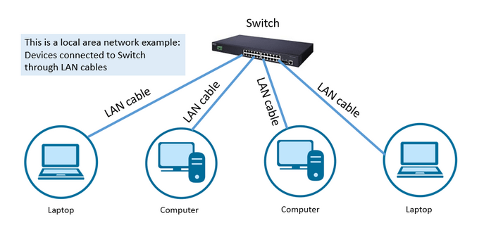
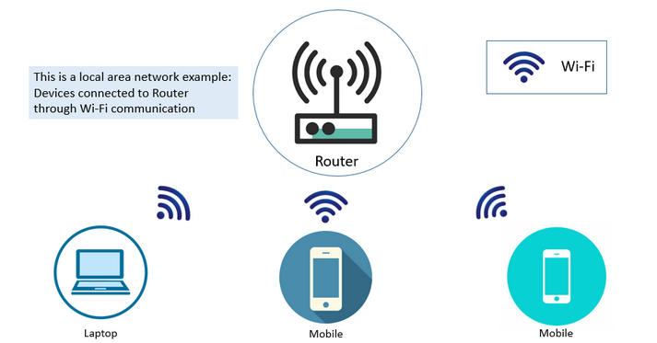
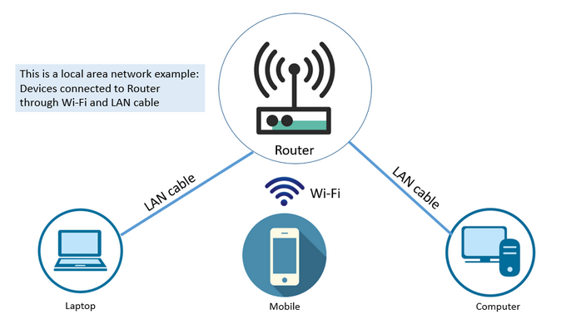
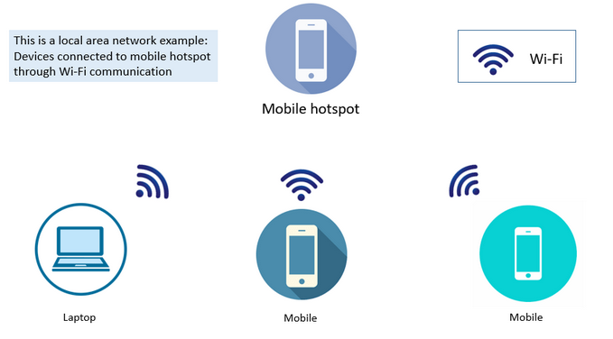
Local Area Network
Notes:
A local area network (LAN) is usually privately owned and links the devices in a single office, building, or campus. LAN size is limited to a few kilometres.
Example
a LAN can be as simple as two PCs and a printer in someone's home office;
It can extend throughout a company and include audio and video peripherals.

Slide 35
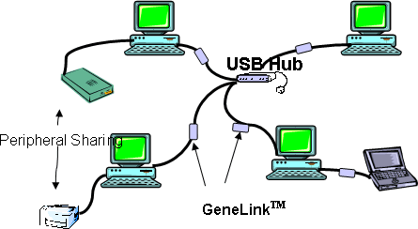
Local Area Network
Local Area Network
LANs are designed to allow resources to be shared between personal computers or workstations.
The resources to be shared can include
hardware (e.g., a printer),
software (e.g., an application program),
data.

Slide 36
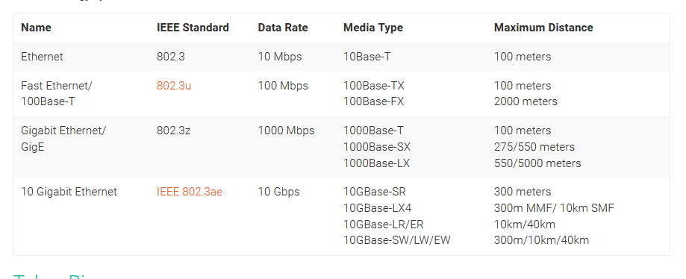
Local Area Network
Local Area Network

Slide 37
Local Area Network
Traditional LANs run at speeds of 100 to 1000 Mbps (but now much higher speeds can be achieved).
High speed LANs are boosting the speed up to 10 Gbps
The most common LAN topologies are:
Bus
Ring
Star

Slide 38
Metropolitan Area Network
MAN is designed to extend over the entire city.
MANs typically cover transmission ranges between 5 and 10 km in diameter and may cover an area the size of a city, or even a group of small buildings.
MANs often act as a high-speed network that allows sharing of regional resources and also provide a shared connection to other networks.
Notes:
MANs are larger than LANs and generally are not owned by a single organization; instead their communications links and equipment are generally owned by either a consortium of users or by a single network provider who sells the service to the users.
MANs can also mean the interconnection of several LANs by bridging them with backbone lines.

Slide 39
Metropolitan Area Network
Wireless metropolitan area networks (WMANs) are used to establish wireless connections between multiple locations within a metropolitan area, such as between multiple office buildings in a city or on a university campus, without the high cost of laying fiber or leasing lines. For optical wires communications, infrared light can be used to transmit data.
MANs is defined IEEE 802.6.
Notes:
MANs are larger than LANs and generally are not owned by a single organization; instead their communications links and equipment are generally owned by either a consortium of users or by a single network provider who sells the service to the users.
MANs can also mean the interconnection of several LANs by bridging them with backbone lines.

Slide 40
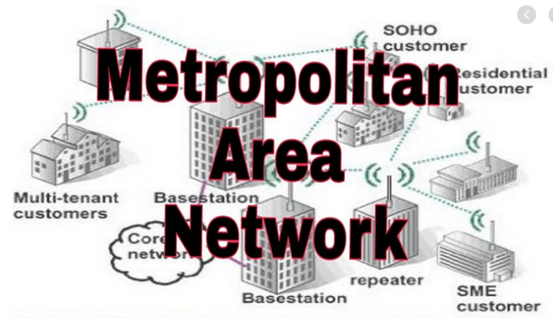
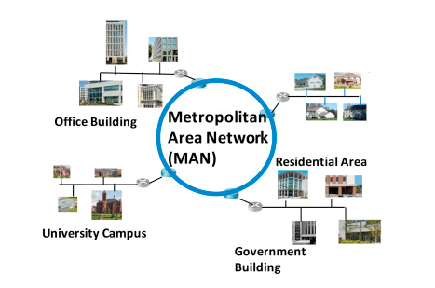
Metropolitan Area Network

Slide 41
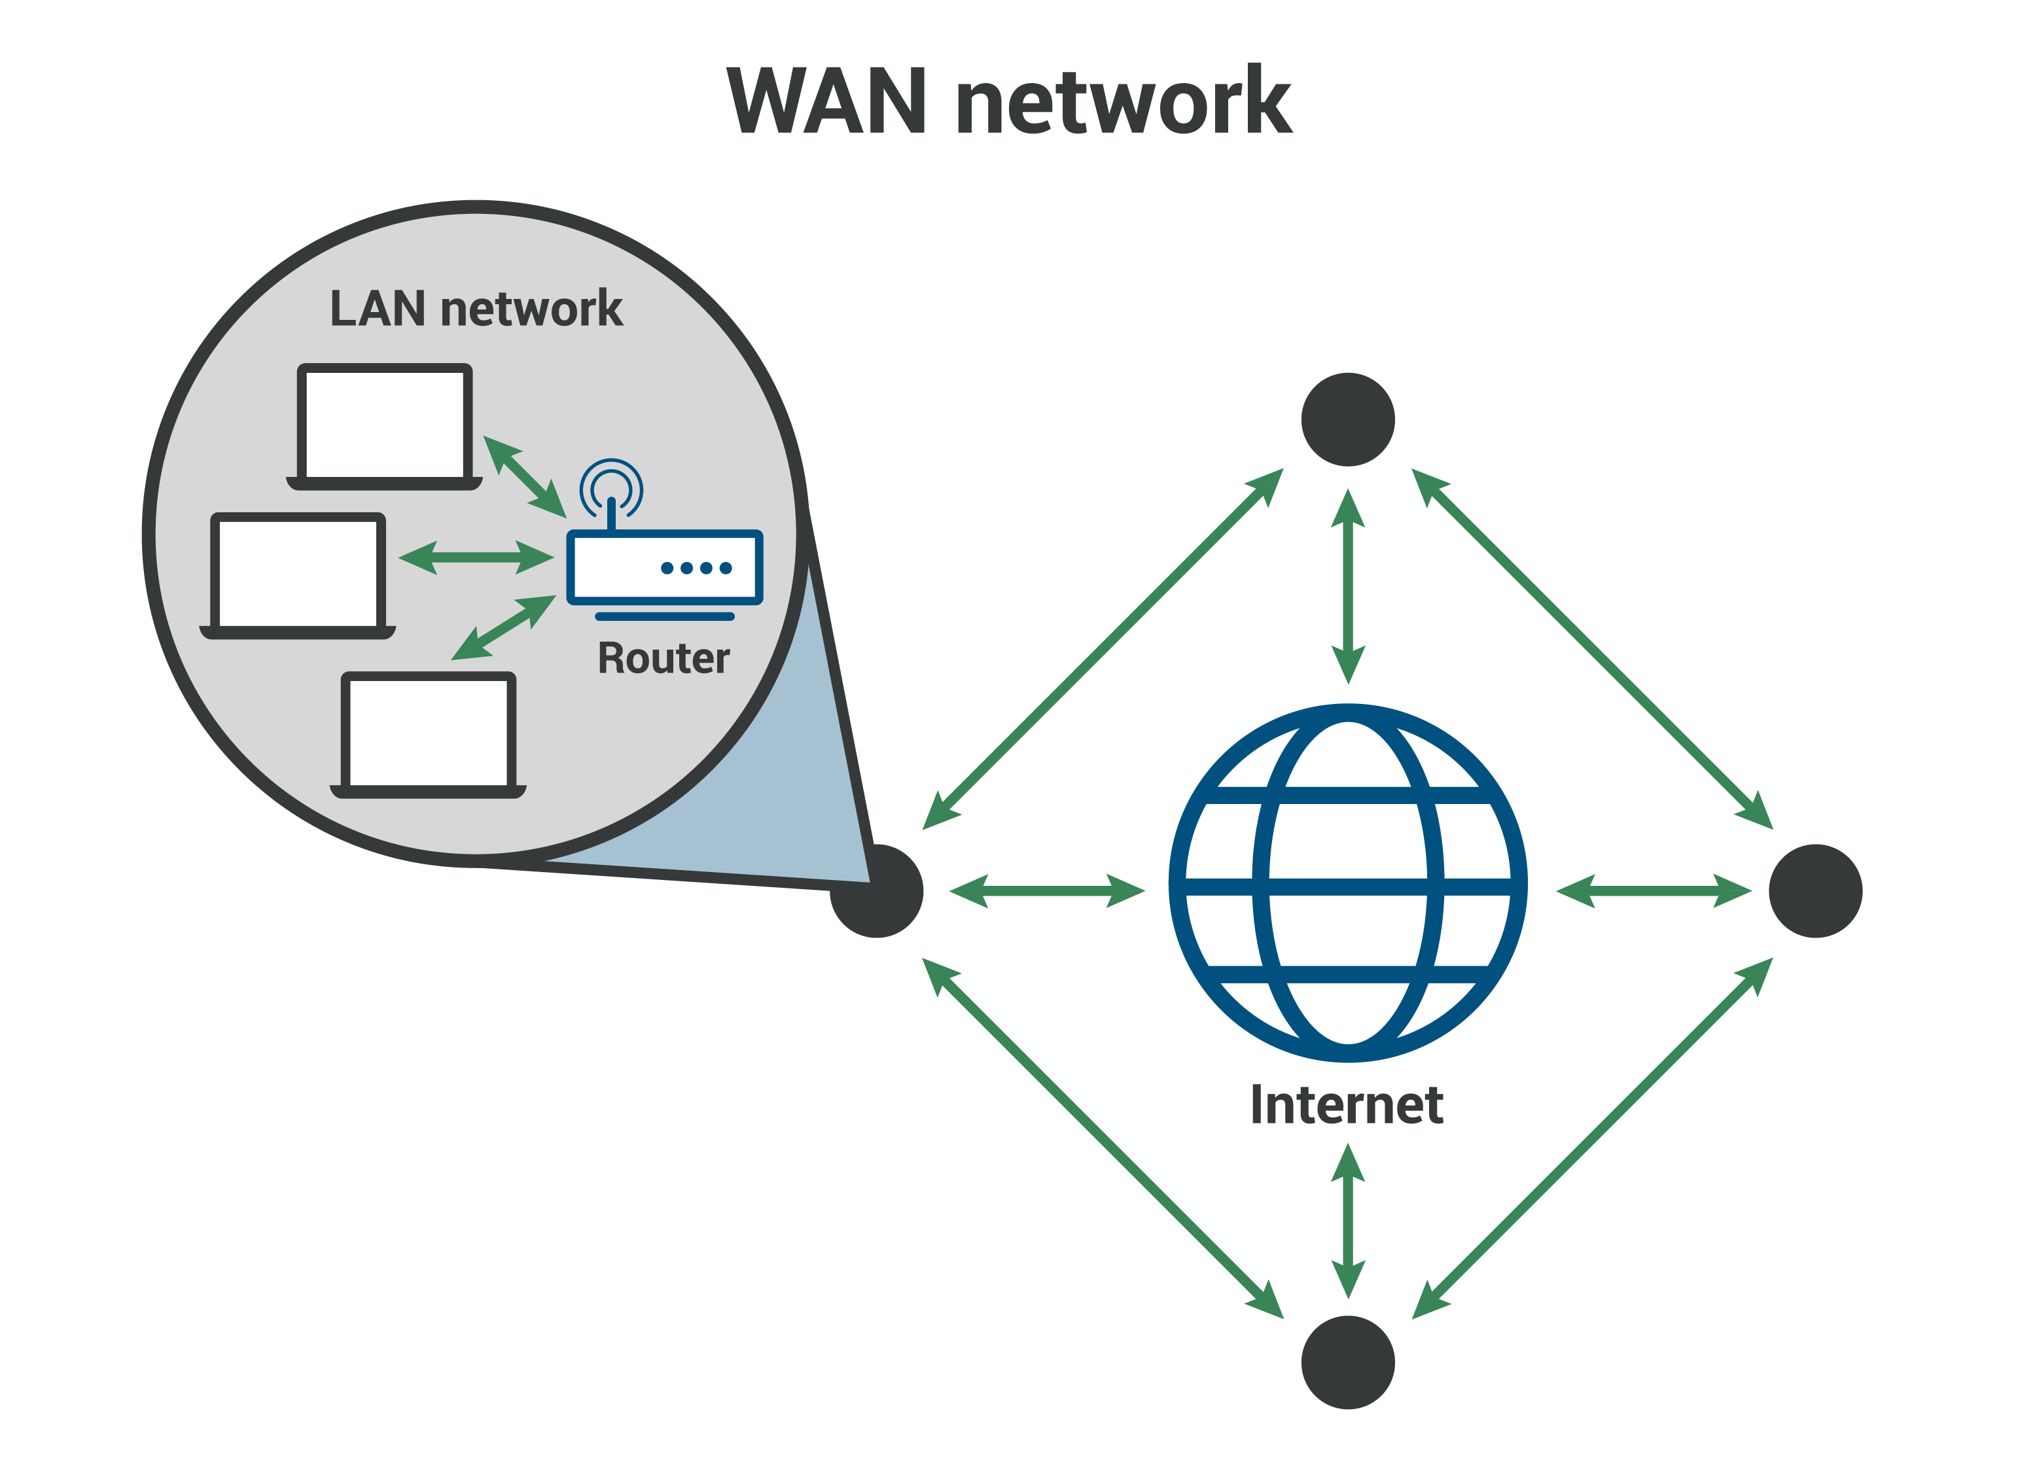
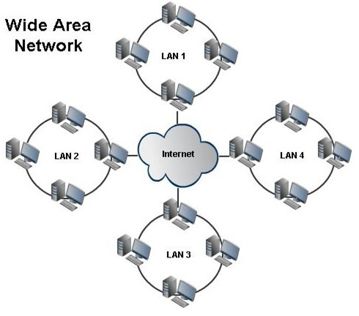
WIDE AREA NETWORK (WAN)
A wide area network (WAN) is a computer network that covers a large geographical area comprising a region, a country, a continent, or even the whole world. WAN includes the technologies to transmit data, image, audio, and video information over long distances and among different LANs and MANs.

Slide 42
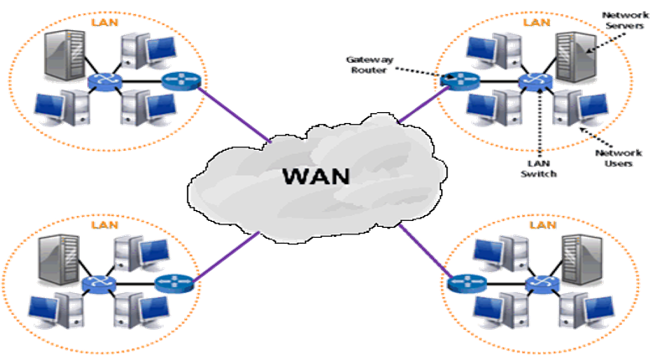
NETWORK TYPES (cont.…)
WIDE AREA NETWORK (WAN)
A WAN is a network that exists over a large-scale geographical area.
A WAN connects different smaller networks, local area networks (LANs), and metro area networks (MANs).
• A WAN interconnects connecting devices such as switches, routers, or modems.
Example of WAN
The Internet
4G Mobile Broadband Systems
A network of bank cash dispensers
A WAN network will have a larger coverage area that can range up to 100,000 KM and in some cases, stretches globally or over international borders.

Slide 43
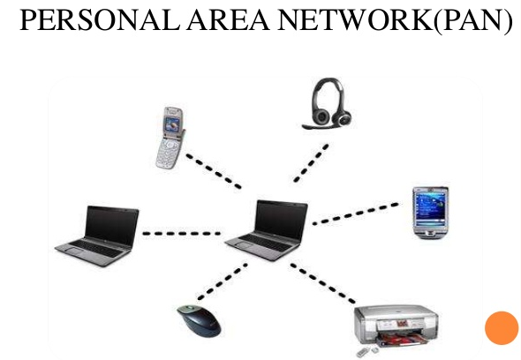
NETWORK TYPES (contd…)

Slide 44
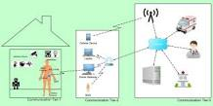
NETWORK TYPES(contd…)
Personal area network (PAN)
• PAN is a computer network for interconnecting devices centered on an individual person's workspace. A PAN provides data transmission among devices such as computers, smartphones, tablets and personal digital assistants.
• PANs can be used for communication among the personal devices themselves, or for connecting to a higher-level network and the Internet where one master device takes up the role as gateway. A PAN may be wireless or carried over wired interfaces such as USB.
• PAN is the interconnection of information technology devices within the range of an individual person, typically within a range of 10 meters.
Personal Area Network (PAN): It is an interconnection of personal technology devices to communicate over a short distance, which is less than 33 feet or 10 meters or within the range of an individual person, typically using some form of wireless technologies.

Slide 45
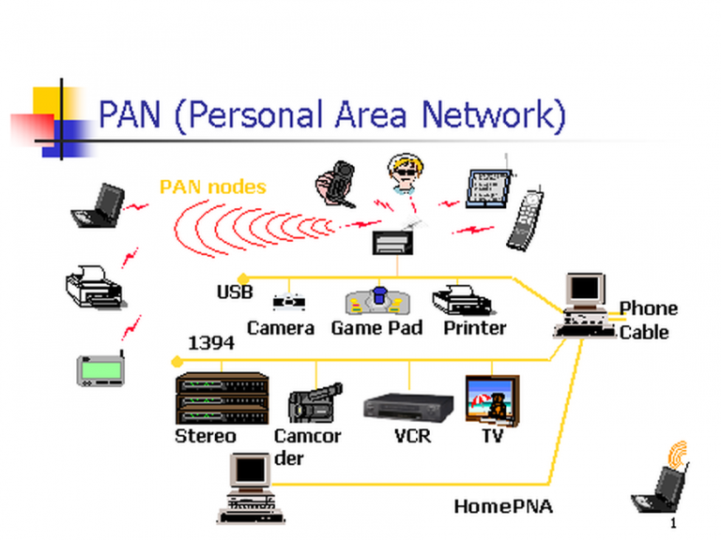
Cont..
Example
A PAN is the connection between a Bluetooth earpiece and a smartphone. PANs can also connect laptops, tablets, printers, keyboards, and other computerized devices.

Slide 46
NETWORK TYPES(contd…)
Wireless personal area network (WPAN)
It is virtually a synonym since almost any personal area network would need to function wirelessly.
Wireless Personal Area Network short known as WPAN. Actually, WPAN is PAN (Personal Area Network) where the interconnected devices are centered around a person’s workspace and connected through the wireless medium
Typically the range is within about 10 meters means a very short range.

Slide 47
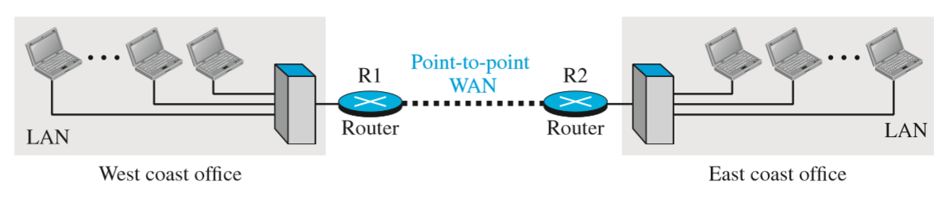
NETWORK TYPES (contd…)
Internetwork
• When two or more networks are connected, they make an internetwork, or internet.
• As an example, assume that an organization has two offices, one on the east coast and the other on the west coast. Each office has a LAN that allows all employees in the office to communicate with each other.
Fig. : An internetwork made of two LANs and one point-to-point WAN

Slide 48
NETWORK TERMS- HOST, WORKSTATIONS, SERVER, CLIENT, NODE
Host
A network host is a computer or other device connected to a computer network. A network host may offer information resources, services, and applications to users or other nodes on the network. A network host is a network node that is assigned a network layer host address
Workstations
A workstation is a special computer designed for technical or scientific applications. Intended primarily to be used by one person at a time, they are commonly connected to a local area network and run multi-user operating systems.

Slide 49
NETWORK TERMS- HOST, WORKSTATIONS, SERVER, CLIENT, NODE
Server
the computer is a core component of the network, providing a link to the resources necessary to perform any task.
Client
computers normally request and receive information over the network client. Client computers also depend primarily on the central server for processing activities

Slide 50
NETWORK DEFINITION
A network is a set of devices (often referred to as nodes) connected by communication links.
A node can be a computer, printer, or any other device capable of sending and/or receiving data generated by other nodes on the network.
A link can be a cable, air, optical fiber, or any medium which can transport a signal carrying information.

Slide 51
PURPOSE OF A NETWORK
The purpose of a network is to share resources.
A resource may be -
A file
A folder
A printer
A disk drive
Or just about anything else that exists on a computer.

Slide 52
NETWORK CRITERIA
A network must be able to meet certain criteria, these are mentioned below:
Performance
Reliability
Scalability
Performance
It can be measured in following ways :
Transit time : It is the time taken to travel a message from one device to another.
Response time : It is defined as the time elapsed between enquiry and response.

Slide 53
NETWORK CRITERIA (contd…)
Other ways to measure performance are :
Efficiency of software
Number of users
Capability of connected hardware
Reliability
It decides the frequency at which network failure take place. More the failures are, less is the network's reliability.

Slide 54
NETWORK CRITERIA (contd…)
Security
It refers to the protection of data from unauthorized users or access. While traveling through a network, data passes many layers of the network, and data can be traced if attempted. Hence security is also a very important characteristic of networks.

Slide 55
PROPERTIES OF GOOD NETWORK
Interpersonal Communication: We can communicate with each other efficiently and easily example emails, chat rooms, video conferencing, etc.
Resources can be shared: We can use the resources provided by the network such as printers etc.
Sharing files, and data: Authorized users are allowed to share the files on the network.

Slide 56
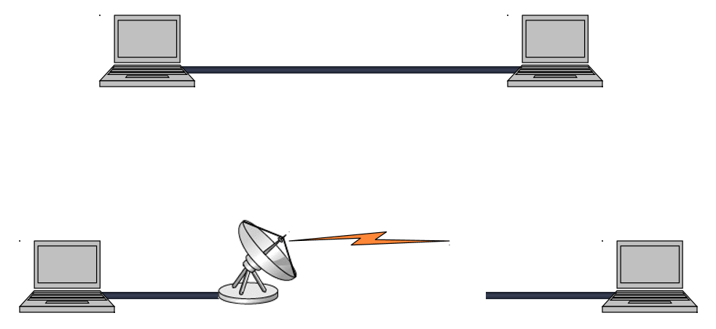
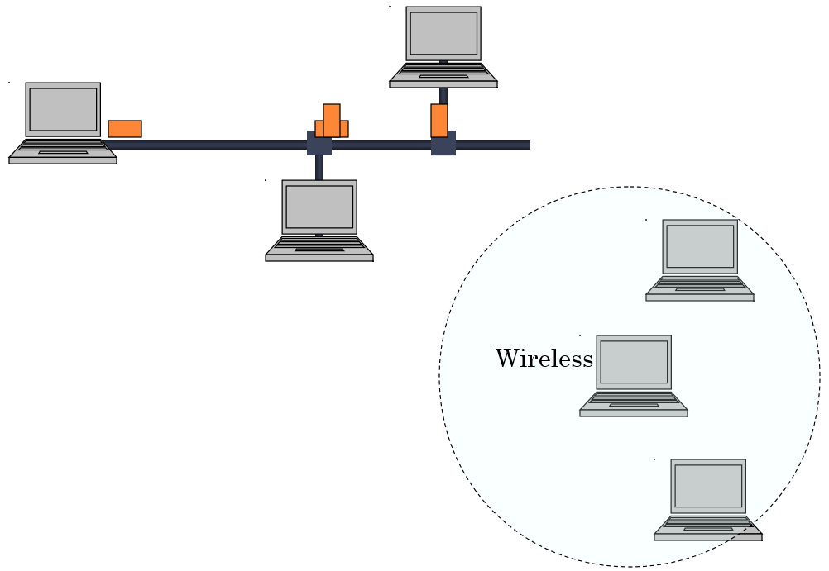
TYPES OF CONNECTIONS
Point-to-point-Dedicated link
Multipoint (Timeshare)-Shares
a single link

Slide 57
ADVANTAGES OF NETWORKING
Connectivity and Communication
Data Sharing
Hardware Sharing
Internet Access
Internet Access Sharing
Data Security and Management
Entertainment

Slide 58
THE DISADVANTAGES OF NETWORKING
Network Hardware, Software, and Setup Costs
Hardware and Software Management and Administration Costs
Undesirable Sharing
Illegal or Undesirable Behaviour
Data Security Concerns

Slide 59
TYPES OF NETWORK ARCHITECTURE
TYPES OF NETWORK ARCHITECTURE
PEER-TO-PEER NETWORK -
Good for small environments, usually up to 10 computers
No dedicated network administrator
Each computer must have specific permissions assigned
Sharing resources can become a problem if the computer with the resource is down
Security is a serious issue

Slide 60
TYPES OF NETWORK ARCHITECTUR (contd…)
2) CLIENT/SERVER NETWORK –
A server has a special Network Operating system (NOS) to help provide resources to multiple users
Client/Server environments usually have one or more network administrators
Problems can include access, security, and integrity of data
Backups are needed in this environment

Slide 61
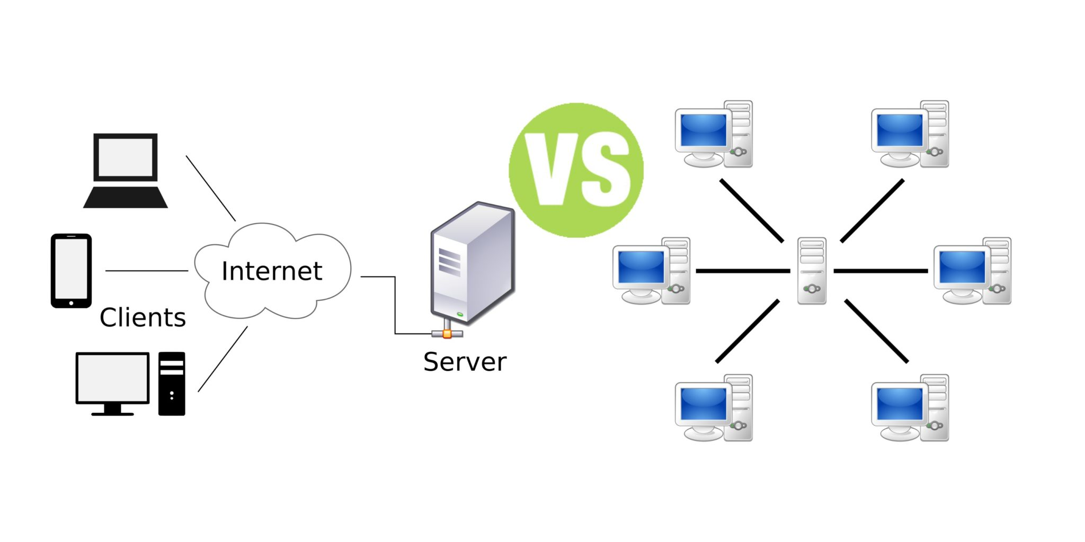
DIFFERENCE BETWEEN CLIENT SERVER NETWORK AND PEER TO PEER NETWORK

Slide 62
NETWORK TOPOLOGY
A topology is a way of “laying out” the network. Topologies can be either physical or logical.
Physical topologies describe how the cables are run.
Logical topologies describe how the network messages travel.

Slide 63
Question:
What is data communication? What are the main components of data communication?
Which communication mode allows communication in both directions simultaneously?
Among LAN, MAN, and WAN, which has the highest speed and which one can cover the largest area?
What is protocol in data communication? Explain with an example.

